Slide 1
Concert Investment: Which Artists Have The Potential To Become Ticket-Selling Artists?
Yiling Lin

Slide 2
Concert Investment:
Which Artists Have The Potential To Become Ticket-Selling Artists?
Target Audience:
Concert Promoters, Artist Management Companies, Entertainment Investors

Slide 3


Datasets
a trade publication for the concert industry
data including 834 top ticket-selling artists from 2017 – early 2020.
data obtained by web scrapping : https://www.pollstar.com/concert-pulse
one of the most popular music streaming service
two datasets including (1) audio features of 160k+ songs released in between 1921 and 2020 and (2) music genres of artists
data obtained from Kaggle: https://www.kaggle.com/yamaerenay/spotify-dataset-19212020-160k-tracks

Slide 4
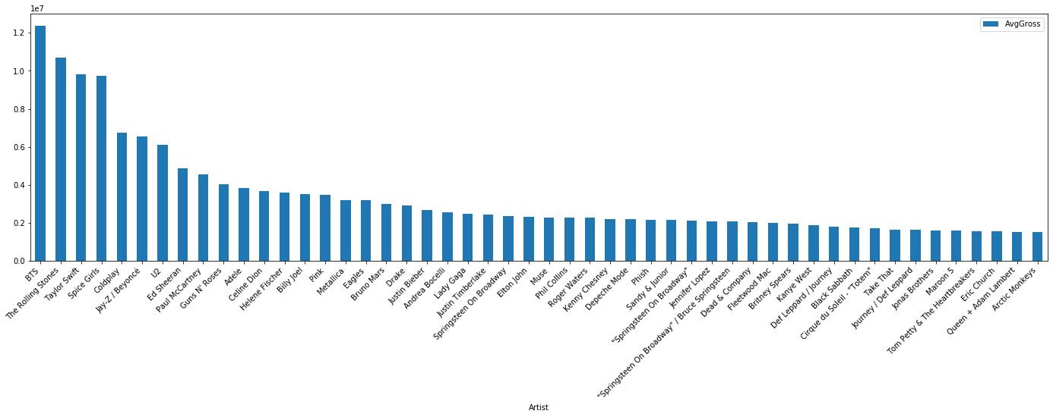
Top 50 Ticket-Selling Artist (Pollstar data)

Slide 5
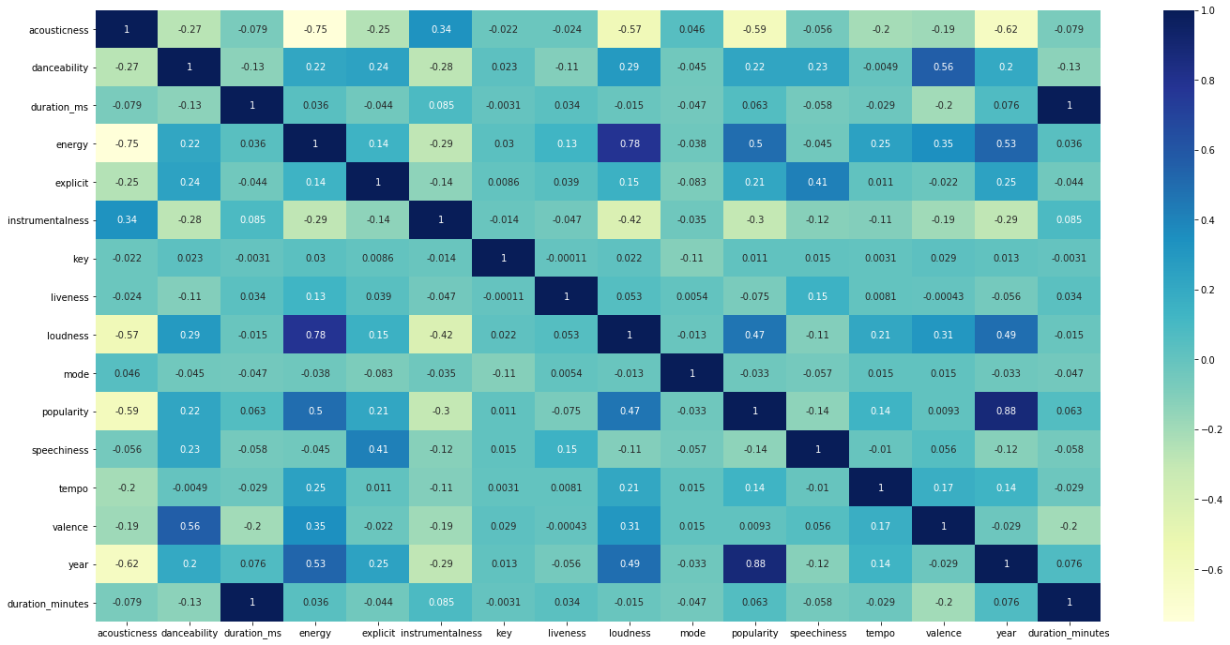
General Music Trend From Spotify Data
Highly correlated variables:
year vs popularity: 0.88
energy vs loudness:
0.78
energy vs acousticness : -0.75
Moderately correlated variables:
acousticness vs year:
0.62
acousticness vs popularity: 0.59
danceability vs valence: 0.56
energy vs year: 0.53
energy vs popularity:0.5

Slide 6
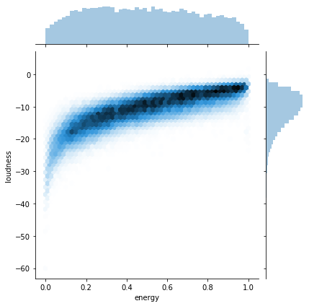
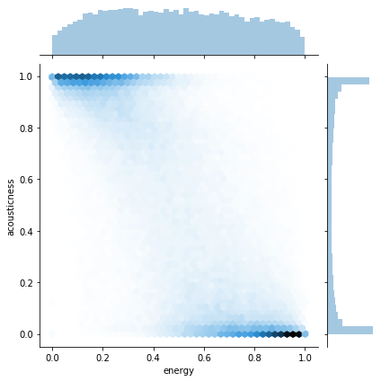
General Music Trend From Spotify Data
The higher the energy is, the louder the music is.
The higher the energy is, the less acoustic the music is.

Slide 7
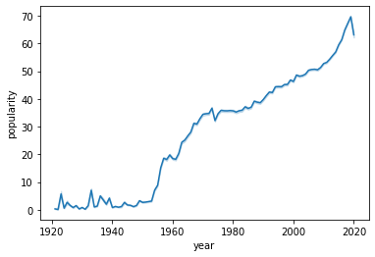
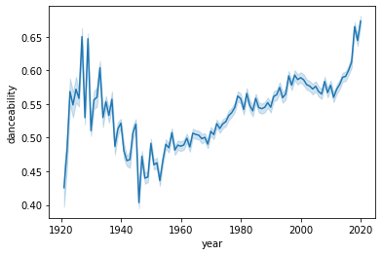
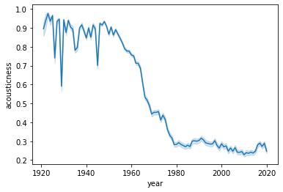
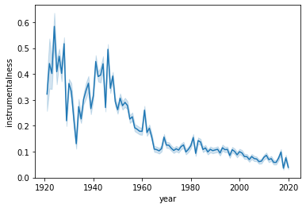
General Music Trend From Spotify Data
The newer a song is, the higher the popularity is.
Danceability decreased significantly from 1935 to 1950 and increased over time after 1950.
Artists make less and less acoustic and instrumental tracks.

Slide 8
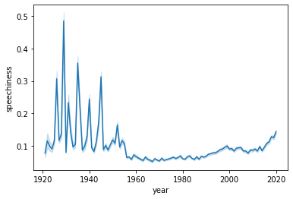
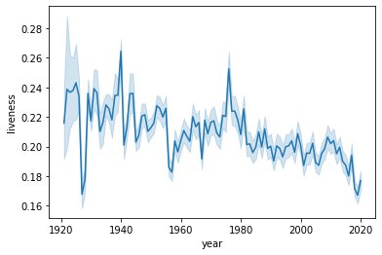
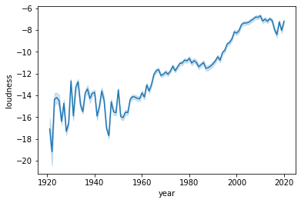
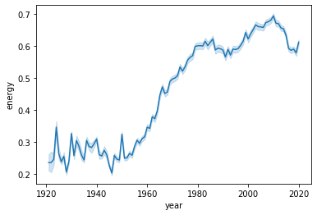
General Music Trend From Spotify Data
Tracks after 1950 feature fewer spoken words than tracks before 1950; however, after 2000, spoken words in tracks started increasing.
Liveness of tracks fluctuate, but in general it is getting lower and lower over years.
Loudness and energy increased significantly after 1960.

Slide 9
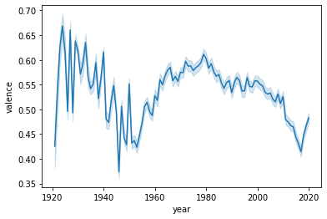
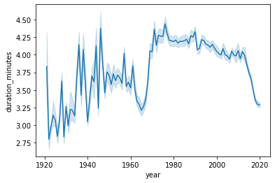
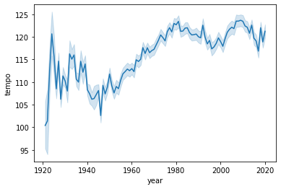
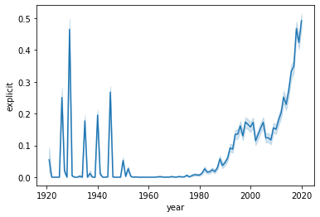
General Music Trend From Spotify Data
Positive vibe of music decreased significantly around 1935 until 1945 and started increasing around 1950 but started decreasing again after 2000.
Duration of songs significantly increased from 1965 to 1980 but started decreasing after 2010.
Tempo of tracks started increasing around 1950.
Explicit lyrics increased significantly after 2000

Slide 10
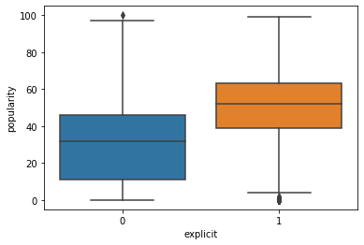
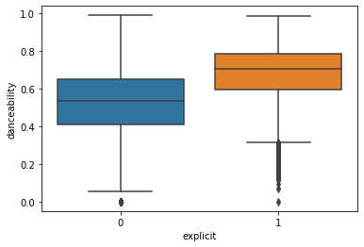
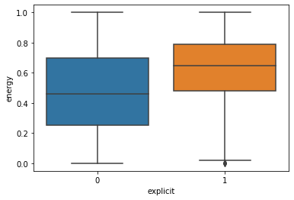
General Music Trend From Spotify Data
Explicit
Explicit tracks account for only 9% of total tracks, but average popularity is 55% higher than non- explicit tracks.
(46.73 vs 30.15)
Explicit tracks averagely have higher danceability and energy than non-explicit tracks.

Slide 11
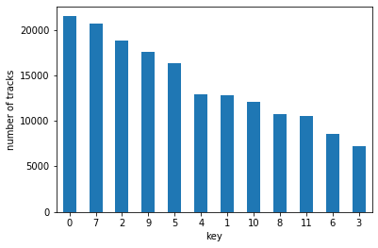
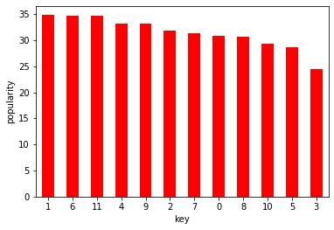
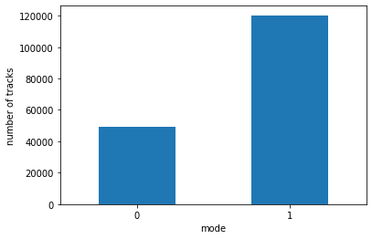
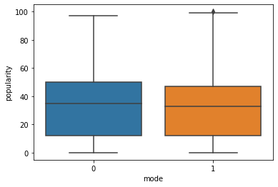
General Music Trend From Spotify Data
Key & Mode
Key: Hard to conclude the
trend as the use of key is more
associated with an artist’s
range/musical arrangement than
external factors.
In general, most tracks are composed of major mode, but the average popularity of minor mode tracks is slightly higher.
0=C
1=C#/D♭
2=D
3=D#/E♭
4=E
5=F
6=F#/G♭
7=G
8=G#/A♭
9=A
10=A#/B♭
11=B

Slide 12
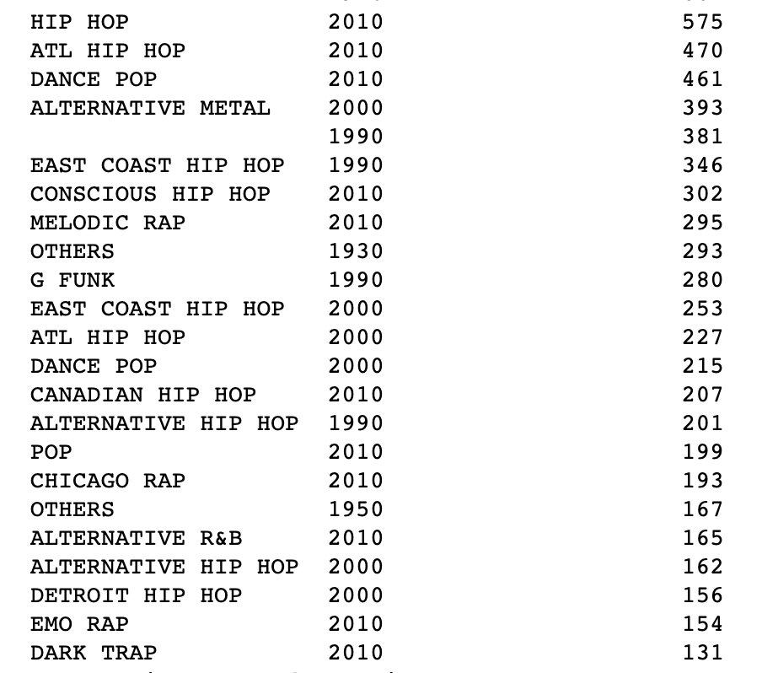
Music Trend vs Social Environment/Context
Pre-War Music vs Post-War Music :
Decrease in danceability, valence, tempo, loudness and energy between 1940-1950.
Music genres and music content (change of the music characteristics) were influenced by wars.
The Rise of Rap Music (2000):
The increase of explicit content.
Streaming Era(2010-present) :
The decrease of duration of songs.
Hook audience’s attention in a short time.
Will TikTok make music even shorter?
Number Of Explicit Songs By Music Genres

Slide 13
Pre-Processing data for Top Ticket-Selling Artist EDA & Machine Learning
Data cleaning
Pollstar dataset - separate co-billing artists and assign each artist to the ‘main_artist’ column
Spotify dataset – extract the first artist from artists column and assign each artist to the ‘main_artist’ column
Genre dataset – extract the first genre from genres column and assign each genre to the ‘main_genre’ column
Make sure the spellings of main artist in each dataset are the same.
Format artist name and genre (to upper case)
Merge Data
Merge Pollstar dataset with Spotify dataset and Genre dataset (merge on ‘main_artist’ column).
Feature Engineering
active_years : year of the newest song released – year of the oldest song released
number_of_releases: how many songs artists have on Spotify
top_artist: if artist is in Pollstar dataset – YES, if not – NO
release_year_interval : categorize year of released songs to 1960, 1970, 1980, 1990, 2000, 2010, 2020. This feature will be only used for EDA, not for machine learning
duration_minutes : ['duration_ms']*1.6666666666667E-5
Column dropped (for EDA table): 'id','artists','duration_ms','release_date', 'year’, ‘genres’
Row dropped: Artists whose active years are more than 80 years.
main_gerne – replacing missing values with ‘’OTHERS’. This feature will be only used for EDA, not for machine learning.

Slide 14
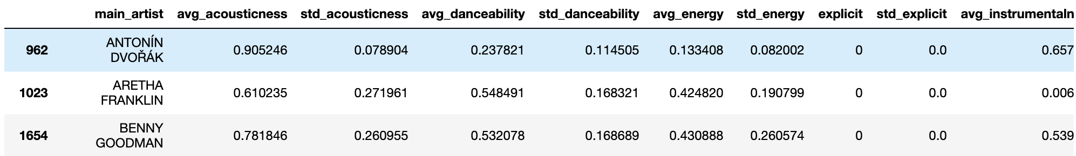
Pre-Processing data for EDA & Machine Learning
Aggregate data based on main artist (mean, standard deviation)
This dataset is an imbalanced dataset (834(4%) top-artist vs 18851(96%) non-top artists)
Size: 19685 (rows) x 30 (columns)

Slide 15
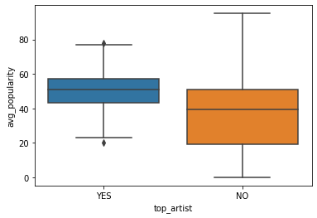
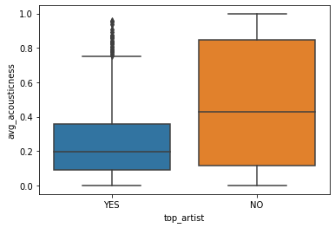
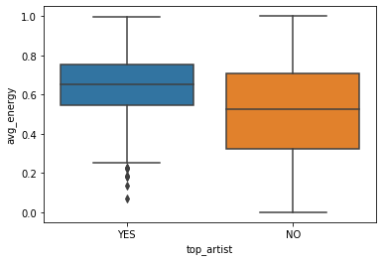
Feature Comparison Between Top Ticket-Selling Artists vs Non-Top Artists
Tracks of top ticket-selling artists have higher popularity on Spotify.
Tracks of of top ticket-selling artists are less acoustic.
Tracks of top ticket-selling artists have more energy.

Slide 16
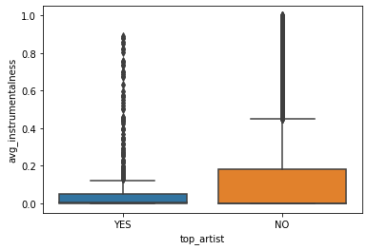
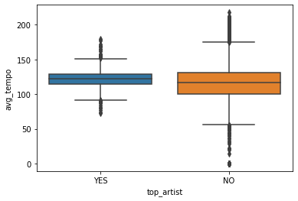
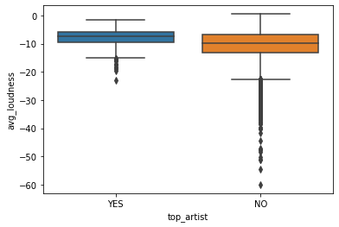
Feature Comparison Between Top Ticket-Selling Artists vs Non-Top Artists
Tracks of top ticket-selling artists are less instrumental.
0.06 (top) vs 0.16(non-top)
Tracks of top ticket-selling artists are slightly faster.
122 (top) vs 117(non-top)
Tracks of top ticket-selling artists are louder.
-7.80 (top) vs -10.71(non-top)

Slide 17
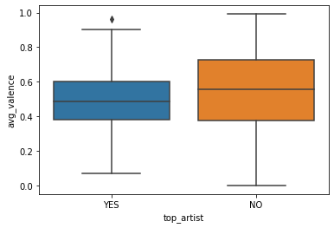
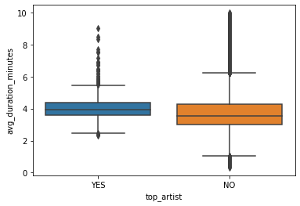
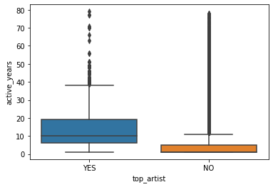
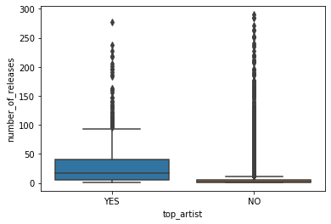
Feature Comparison Between Top Ticket-Selling Artists vs Non-Top Artists
Tracks of top ticket-selling artists have a slight lower valence value.
*Tracks with high valence sound more positive (e.g. happy, cheerful, euphoric), while tracks with low valence sound more negative (e.g. sad, depressed, angry)
Duration of tracks of top ticket-selling artists is averagely slightly longer.
4.05 (YES) vs 3.80 (NO)
Averagely, top ticket-selling artists have been active in the market longer than other artists.
14 years (YES) vs 6 years(NO)
Averagely, top ticket-selling artists release more tracks.
34(YES) vs 7(YES)
(data excluding number of releases > 300.

Slide 18
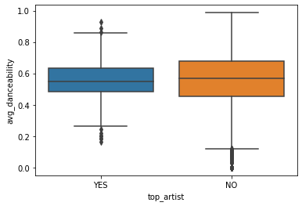
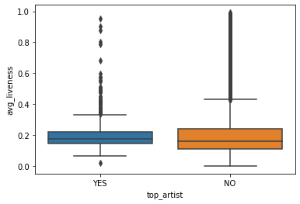
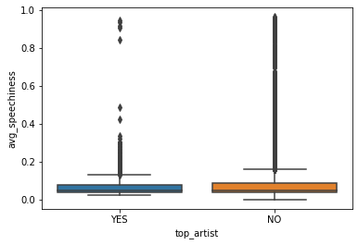
Feature Comparison Between Top Ticket-Selling Artists vs Non-Top Artists
Features have no significant difference between top ticket-selling artists and non-top ticket-selling artists: danceability, liveness, speechiness.

Slide 19
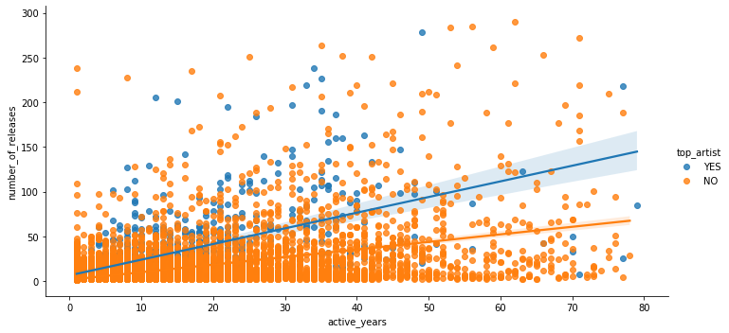
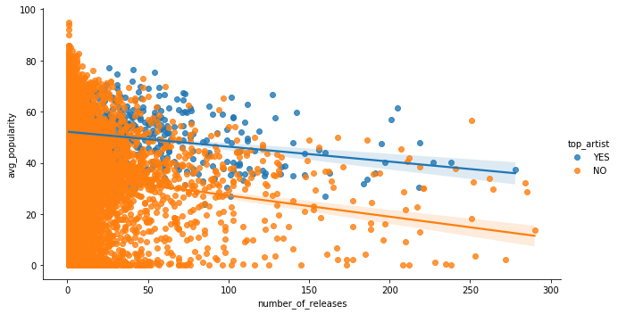
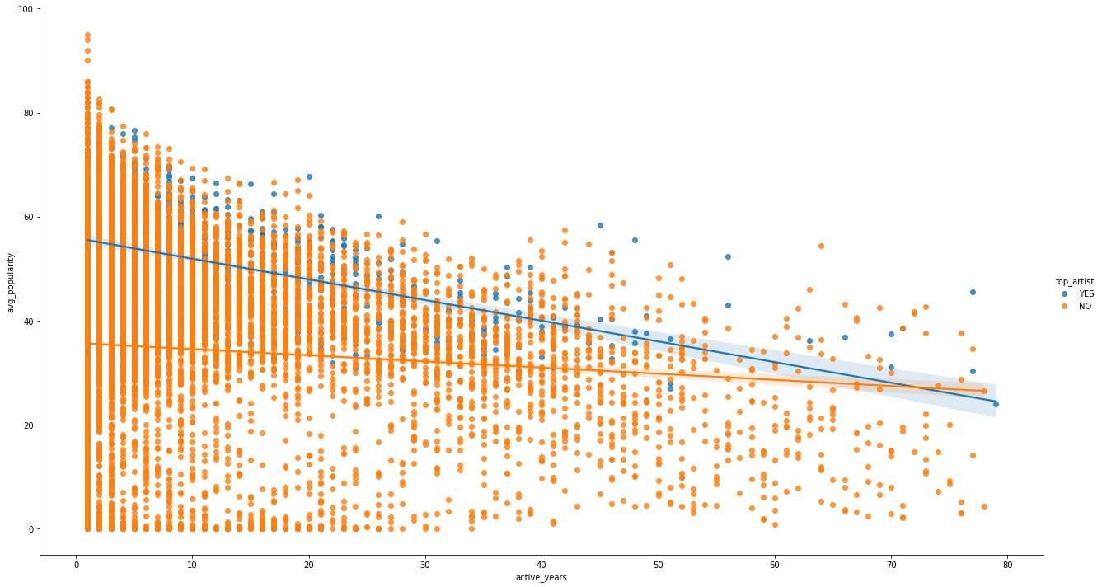
Feature Comparison Between Top Ticket-Selling Artists vs Non-Top Artists
The longer artists have been active in the industry, the more tracks they release (but mainly under 100 tracks).
As the active years increase, the popularity decreases. The change is more obvious among top artists.
Top artists release more tracks than non-top artists and are active in the market longer.

Slide 20
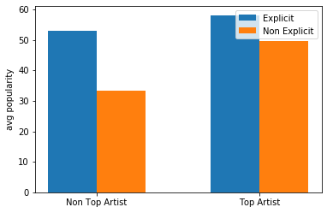
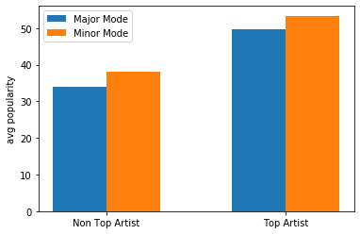
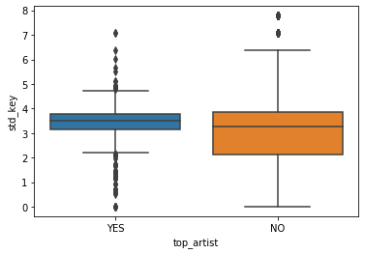
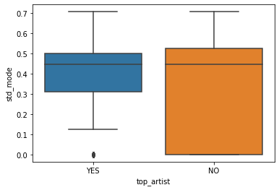
Feature Comparison Between Top Ticket-Selling Artists vs Non-Top Artists
Averagely artists who release explicit content are more popular than artists who release non-explicit content in general (although non-explicit songs account for major part of all songs).
Most artists use major mode in music, but artists who use minor mode more often are popular.
The variations of key and mode of top artists and non-top artists are not much different.

Slide 21
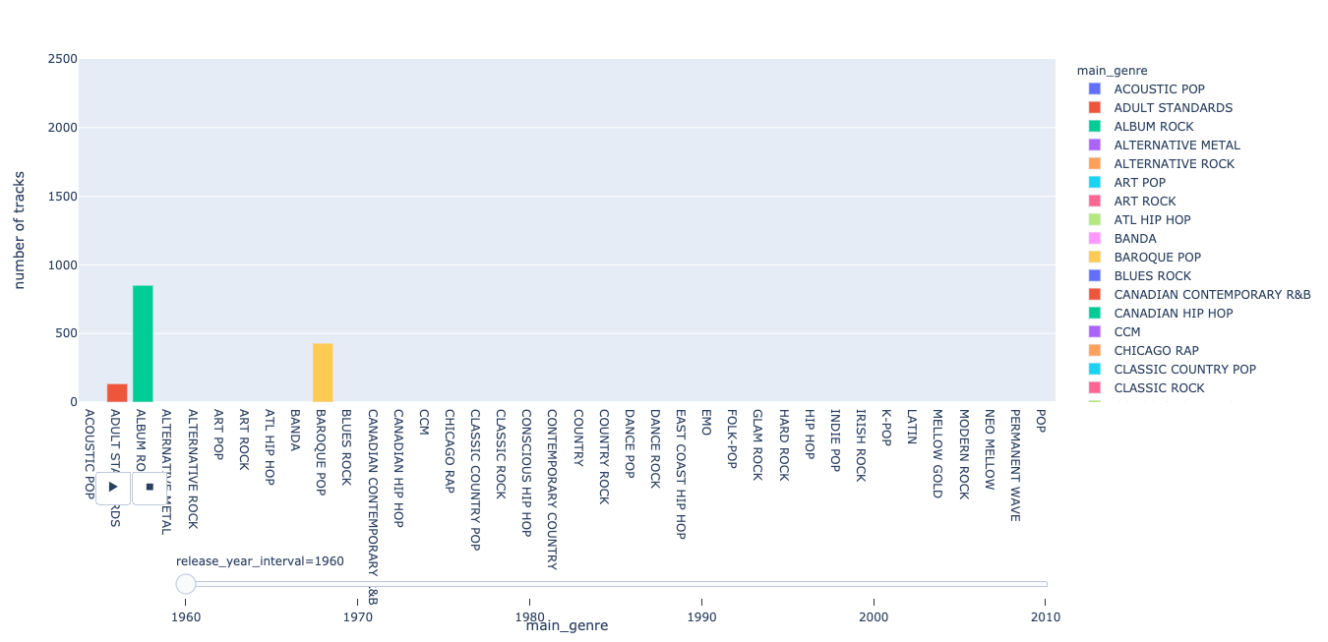
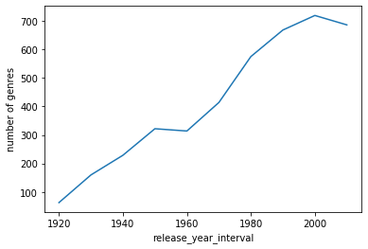
Music Genres Analysis
Genres increases over years
Music Genres of Top Ticket-Selling Artists
Rock is dead?
Pop and Hip Hop started dominating the market after 2000.
K-pop and Latin music started getting popular from 2010.
*Top Music Genres Link

Slide 22
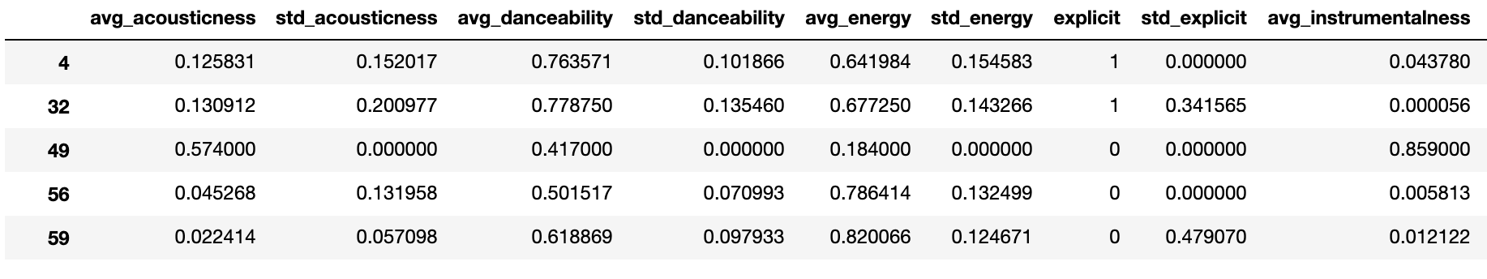
Machine Learning Dataset
Data Imputation
- standard deviation: 0
- main genre : Others
Feature Engineering
Column Added:
- target:
1 (Top Artist )
2 (Non-Top Artist)
Column Dropped
- main_artist, main_genre

Slide 23
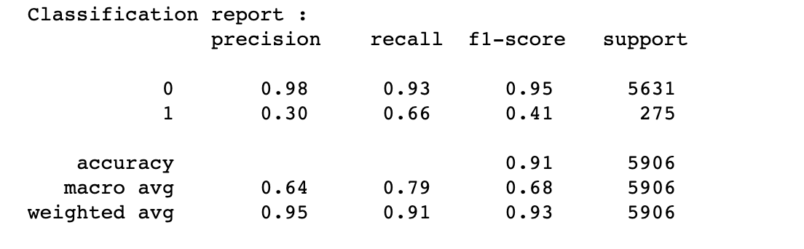
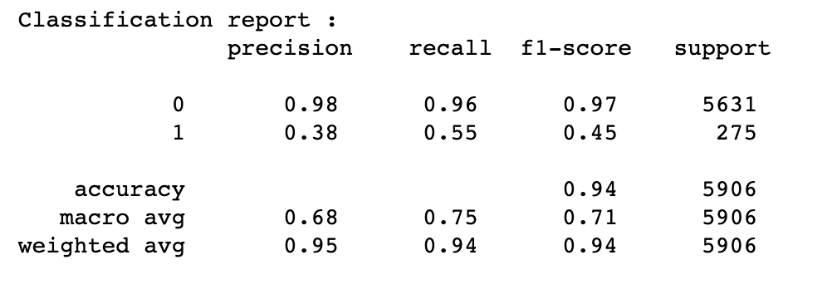

Machine Learning Model: Random Forest Classifier
Model 1
cross validation score (auc_roc): 0.92
train score (auc-roc): 0.98
test score(auc-roc): 0.91
false positive rate: 0.07
false negative rate: 0.33
Model 2
cross validation score (auc_roc): 0.92
train score (auc-roc): 0.99
test score(auc-roc): 0.90
false positive rate: 0.04
false negative rate: 0.45
Model 3
cross validation score (auc_roc): 0.91
train score (auc-roc): 0.99
test score(auc-roc): 0.90
false positive rate: 0.03
false negative rate: 0.55

Slide 24



Number of releases, popularity, active years, duration minutes and acousticness are the top 5 indicators when predicting the artists.

Slide 25

Machine Learning Model: Logistic Regression
train score(auc_roc): 0.91
test score(auc-roc): 0.90

Slide 26
Recommendation & Conclusion
Choose the model with the highest precision score: Model 3
Cost:
A non-top artist predicted to be top-artist (FP error) > A top artist predicted to be a non-top artist (FN error).
e.g.
When a non-top artist is predicted to be a top-artists, the cost and the revenue of tours/concerts might be overestimated and brings back zero return
and even lose money.
Projected Cost: 1M; Projected Revenue: 2M; Actual Revenue $500,000
When a top artist is predicted to be a non-top artist it is less possible to overestimate the cost and the revenue. The investment risk is lower.
e.g.
Projected Cost: $250,000; Projected Revenue: $500,000; Actual Revenue $1M
Important features: Number of releases, average popularity, active years, , acousticness.
Explicit: Although feature importance does not show this feature, this is a very distinct feature in EDA and it’s been growing significantly after 2000, so it is worth taking this feature into consideration too.
What music is hip now?
e.g. Investing in hiphop artists might be less risky in the next few years than investing rock musicians based on the current trend of music.
Music is sensitive to social environment: Evaluate if your artists and their work fit for the current social context/environment , especially when touring internationally.
*Please note that some artists do not use Spotify not because they are not popular; instead, they are too popular to settle their compensation with Spotify.

Slide 27
What To Do Next
Work On Music Genres – re-classify genres (make genres less)
Time Series – Dig into actual concert dates in order to select data points that will help improve the prediction.
Artists’ most active years – find out what years artists are most active in the industry

